Slide 1
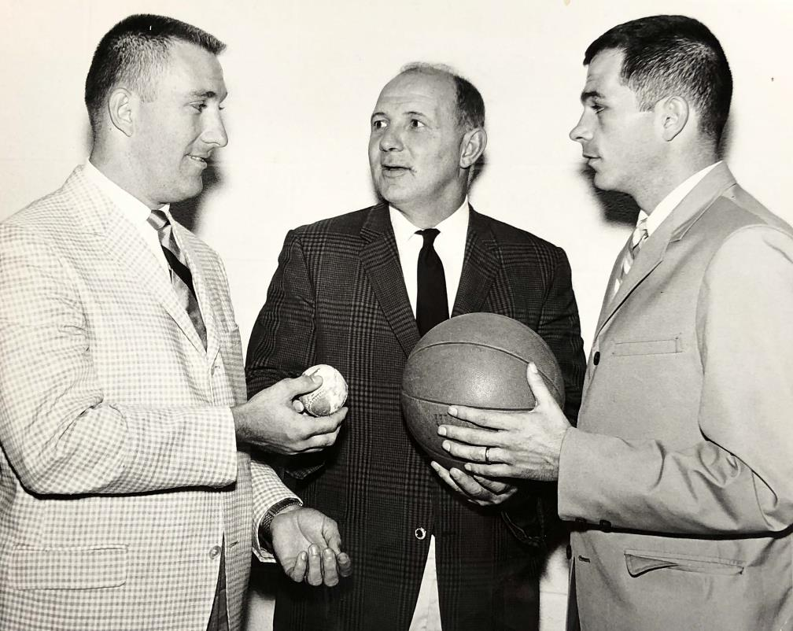
Dick Rockwell
Tom Niland Jr.
Tom Cooney ‘64

Slide 2
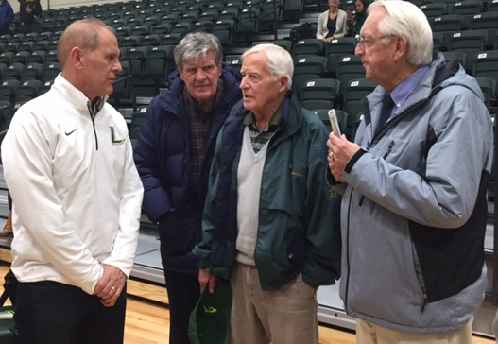
John Beilein
Bill Phillips ’56
John Caveny ‘62
Dick Kenyon ‘56

Slide 3
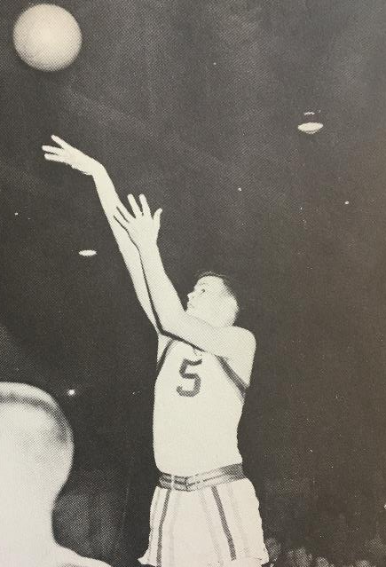
Dick Kenyon ‘56
Dick Lynch ‘60

Slide 4
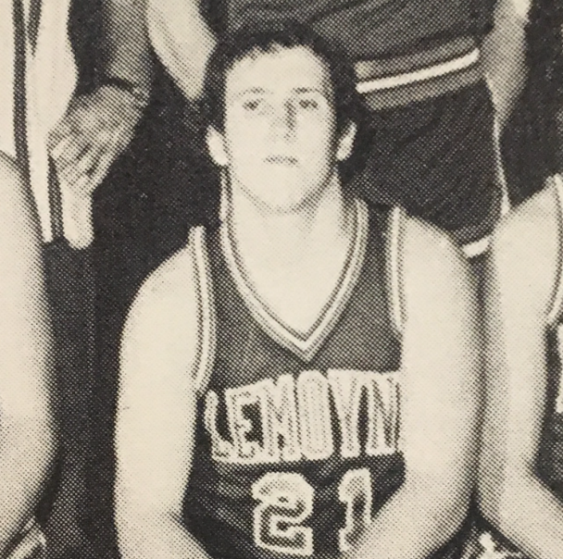
Dennis Niland ‘70
John Niland ‘79

Slide 5
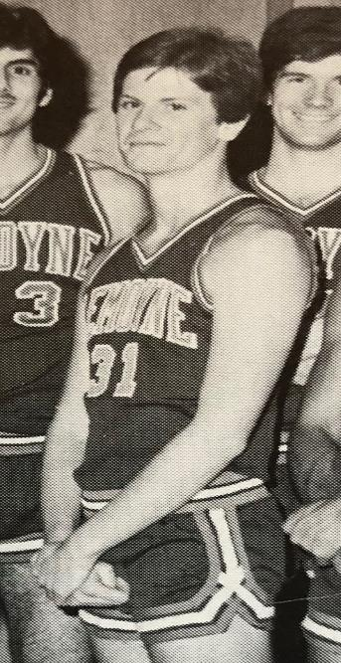
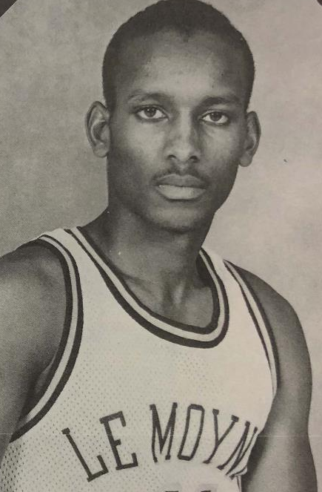
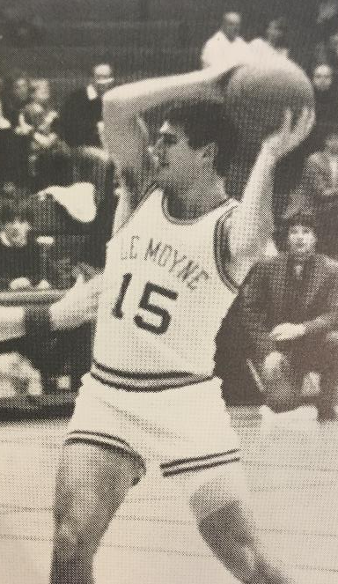
Joe fletcher ‘81
Paul Galvin '84
Walter Hill '87

Slide 6
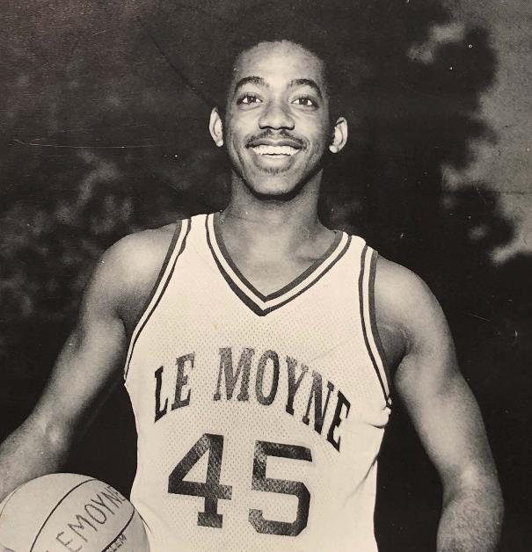
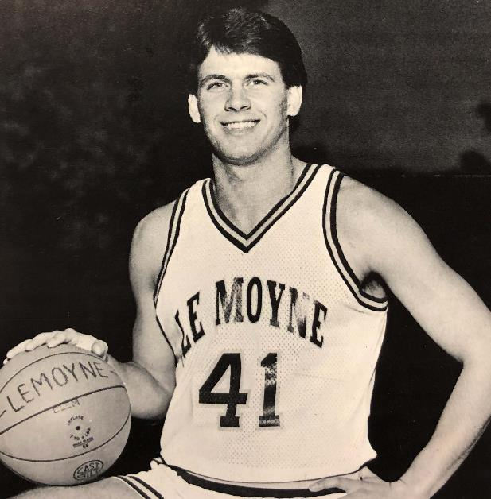
Jim Henderson '87
Scott Hicks '88

Slide 7
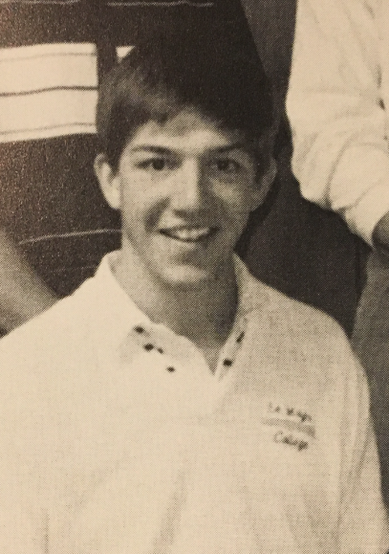
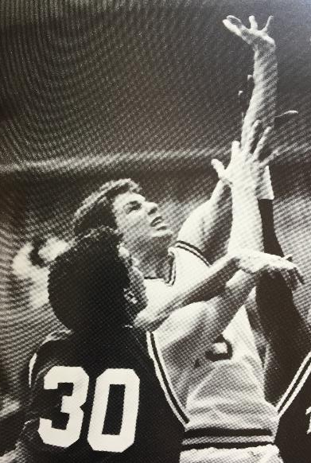
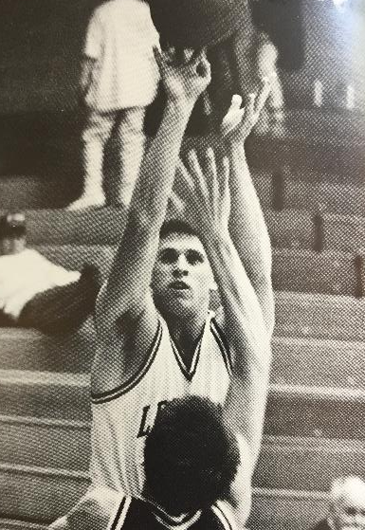
James
Cunningham '90
Nicholas
Masterpole '90
Leonard Rauch '91

Slide 8
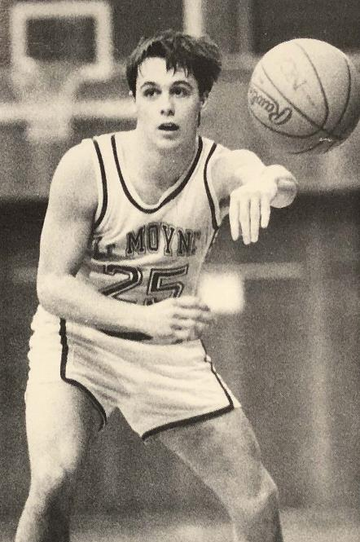
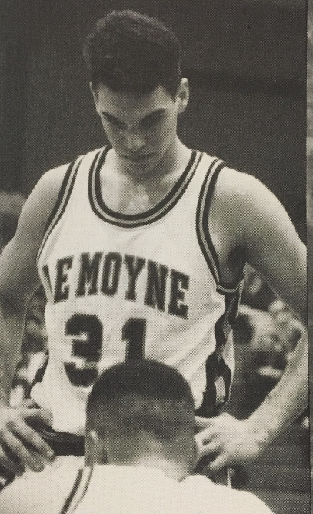
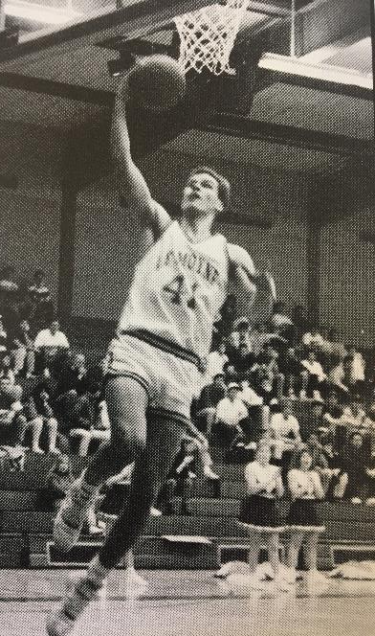
John
Haas '93
Christian
Buchholz '93
Bryan
Menar '98

Slide 9
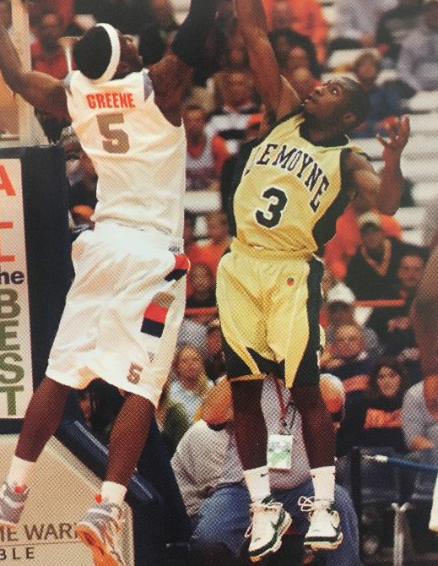
Damani Corbin ‘09
MBA ‘10
Head Coach
Nate Champion ‘14

